Slide 1
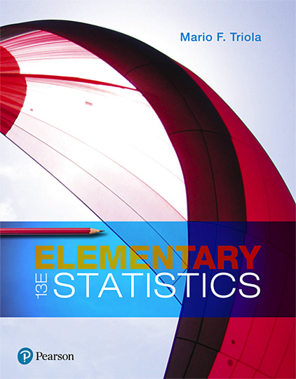
Elementary Statistics
Thirteenth Edition
Chapter 7
Estimating Parameters and Determining Sample Sizes
Copyright © 2018, 2014, 2012 Pearson Education, Inc. All Rights Reserved

Slide 2
Estimating Parameters and Determining Sample Sizes
7-1 Estimating a Population Proportion
7-2 Estimating a Population Mean
7-3 Estimating a Population Standard Deviation or Variance
7-4 Bootstrapping: Using Technology for Estimates

Slide 3
Key Concept
The preceding sections presented methods for estimating population proportions, means, and standard deviations (or variances). All of those methods have certain requirements that limit the situations in which they can be used. When some of the requirements are not satisfied, we can often use the bootstrap method to estimate a parameter with a confidence interval. The bootstrap method typically requires the use of software.

Slide 4
Bootstrap Sample
Bootstrap Sample
Given a simple random sample of size n, a bootstrap sample is another random sample of n values obtained with replacement from the original sample.

Slide 5
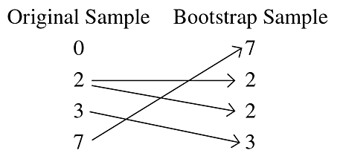
Example: Bootstrap Sample of Incomes (1 of 2)
When the author collected annual incomes of current statistics students, he obtained these results (in thousands of dollars): 0, 2, 3, 7.

Slide 6
Example: Bootstrap Sample of Incomes (2 of 2)
The sample of {7, 2, 2, 3} is one bootstrap sample obtained from the original sample. Other bootstrap samples may be different.
Incomes tend to have distributions that are skewed instead of being normal, so we should not use the methods of Section 7-2 with a small sample of incomes. This is a situation in which the bootstrap method comes to the rescue.

Slide 7
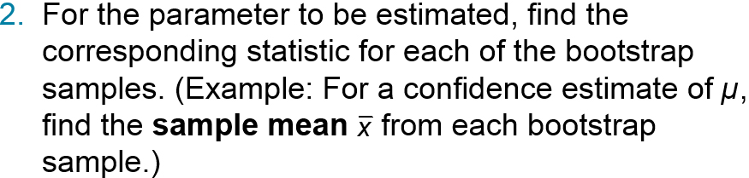
Bootstrap Procedure for a Confidence Interval Estimate of a Parameter (1 of 2)
Given a simple random sample of size n, obtain many (such as 1000 or more) bootstrap samples of the same size n.
Sort the list of sample statistics from low to high.

Slide 8
Bootstrap Procedure for a Confidence Interval Estimate of a Parameter (2 of 2)
Using the sorted list of the statistics, create the confidence interval by finding corresponding percentile values. Procedures for finding percentiles are given in Section 3-3. (Example: Using a list of sorted sample means, the 90% confidence interval limits are P₅ and P₉₅. The 90% confidence interval estimate of µ is P₅ < µ < P₉₅.)

Slide 9
Proportions
When working with proportions, it is very helpful to represent the data from the two categories by using 0’s and 1’s.

Slide 10
Example: Eye Color Survey: Bootstrap CI for Proportion (1 of 11)
In a survey, four randomly selected subjects were asked if they have brown eyes, and here are the results: 0, 0, 1, 0 (where 0 = no and 1 = yes). Use the bootstrap resampling procedure to construct a 90% confidence interval estimate of the population proportion p, the proportion of people with brown eyes in the population.

Slide 11
Example: Eye Color Survey: Bootstrap CI for Proportion (2 of 11)
Solution
Requirement Check
The sample is a simple random sample. (There is no requirement of at least 5 successes and at least 5 failures or np ≥ 5 and nq ≥ 5. There is no requirement that the sample must be from a normally distributed population.)

Slide 12
Example: Eye Color Survey: Bootstrap CI for Proportion (3 of 11)
Solution
Step 1:
In the table on the next slide, we created 20 bootstrap samples from the original sample of 0, 0, 1, 0.

Slide 13
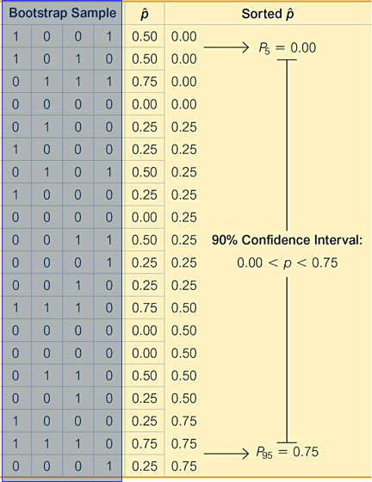
Example: Eye Color Survey: Bootstrap CI for Proportion (4 of 11)
Solution
Bootstrap Samples for p.

Slide 14
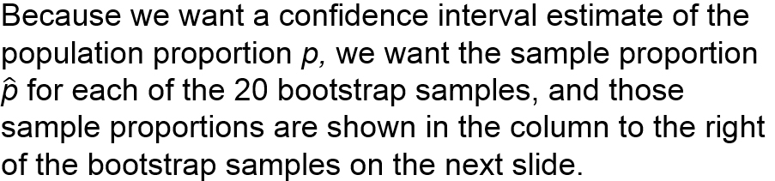
Example: Eye Color Survey: Bootstrap CI for Proportion (5 of 11)
Solution
Step 2:

Slide 15
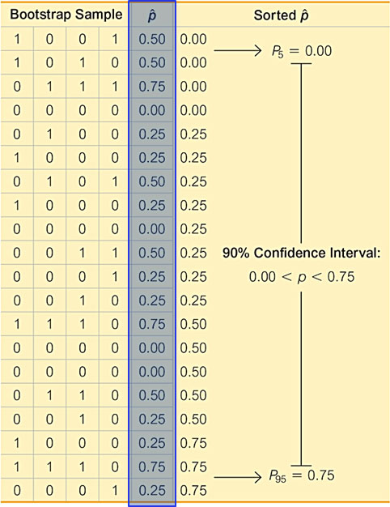
Example: Eye Color Survey: Bootstrap CI for Proportion (6 of 11)
Solution
Bootstrap Samples for p.

Slide 16
Example: Eye Color Survey: Bootstrap CI for Proportion (7 of 11)
Solution
Step 3:
The column of data shown farthest to the right is a list of the 20 sample proportions arranged in order (“sorted”) from lowest to highest.

Slide 17
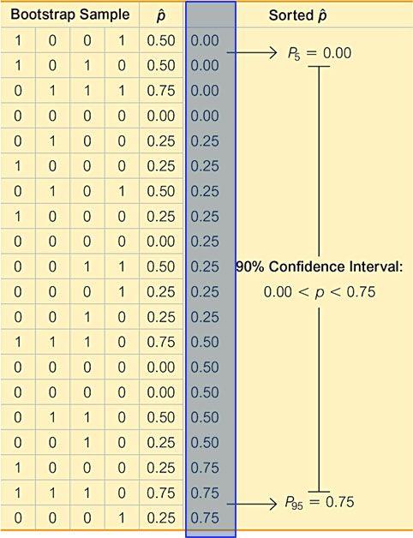
Example: Eye Color Survey: Bootstrap CI for Proportion (8 of 11)
Solution
Bootstrap Samples for p.

Slide 18
Example: Eye Color Survey: Bootstrap CI for Proportion (9 of 11)
Solution
Step 4:
Because we want a confidence level of 90%, we want to find the percentiles P₅ and P₉₅. Recall that P₅ separates the lowest 5% of values, and P₉₅ separates the top 5% of values.
Using the methods from Section 3-3 for finding percentiles, we use the sorted list of bootstrap sample proportions to find that P₅ = 0.00 and P₉₅ = 0.75. The 90% confidence interval estimate of the population proportion is 0.00 < p < 0.75.

Slide 19
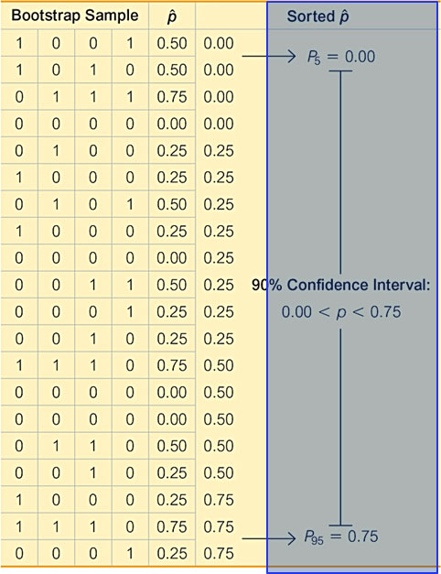
Example: Eye Color Survey: Bootstrap CI for Proportion (10 of 11)
Solution
Bootstrap Samples for p.

Slide 20
Example: Eye Color Survey: Bootstrap CI for Proportion (11 of 11)
Interpretation
The confidence interval of 0.00 < p < 0.75 is quite wide. After all, every confidence interval for every proportion must fall between 0 and 1, so the 90% confidence interval of 0.00 < p < 0.75 doesn’t seem to be helpful, but it is based on only four sample values.

Slide 21
Means
Earlier in this chapter we noted that when constructing a confidence interval estimate of a population mean, there is a requirement that the sample is from a normally distributed population or the sample size is greater than 30. The bootstrap method can be used when this requirement is not satisfied.

Slide 22
Example: Incomes: Bootstrap CI for Mean (1 of 10)
When the author collected a simple random sample of annual incomes of his statistics students, he obtained these results (in thousands of dollars): 0, 2, 3, 7. Use the bootstrap resampling procedure to construct a 90% confidence interval estimate of the mean annual income of the population of all of the author’s statistics students.

Slide 23
Example: Incomes: Bootstrap CI for Mean (2 of 10)
Solution
Requirement Check
The sample is a simple random sample and there is no requirement that the sample must be from a normally distributed population. Because distributions of incomes are typically skewed instead of normal, we should not use the methods of Section 7-2 for finding the confidence interval, but the bootstrap method can be used.

Slide 24
Example: Incomes: Bootstrap CI for Mean (3 of 10)
Solution
Step 1:
In the table on the next slide, we created 20 bootstrap samples (with replacement!) from the original sample of 0, 2, 3, 7. (Here we use only 20 bootstrap samples so we have a manageable example that doesn’t occupy many pages of text, but we usually want at least 1000 bootstrap samples.)

Slide 25
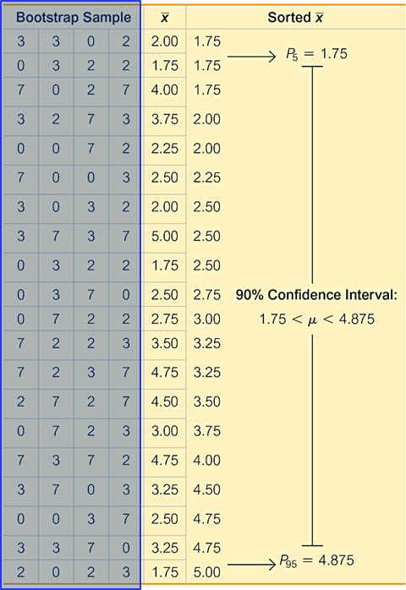
Example: Incomes: Bootstrap CI for Mean (4 of 10)
Solution
Bootstrap Samples for μ.

Slide 26
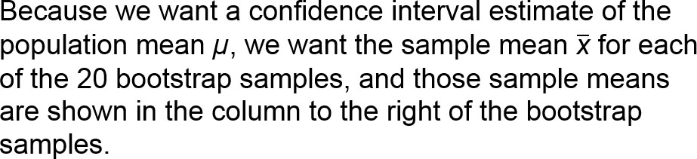
Example: Incomes: Bootstrap CI for Mean (5 of 10)
Solution
Step 2:

Slide 27
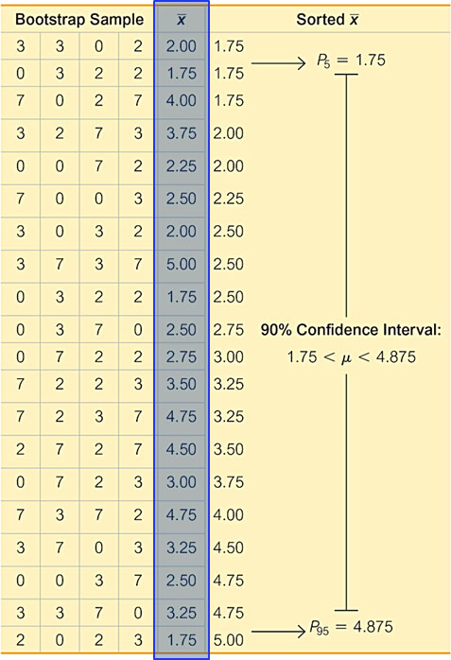
Example: Incomes: Bootstrap CI for Mean (6 of 10)
Solution
Bootstrap Samples for μ.

Slide 28
Example: Incomes: Bootstrap CI for Mean (7 of 10)
Solution
Step 3:
The column of data shown farthest to the right is a list of the 20 sample means arranged in order (“sorted”) from lowest to highest.

Slide 29
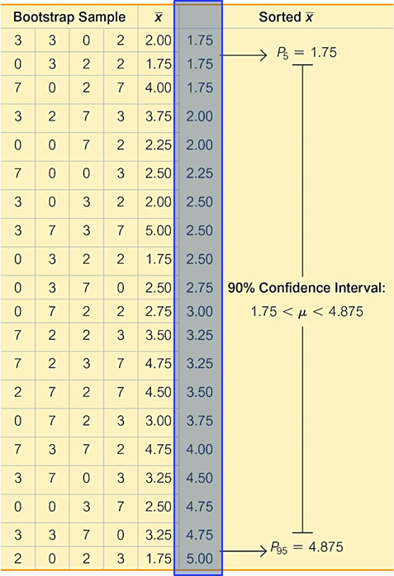
Example: Incomes: Bootstrap CI for Mean (8 of 10)
Solution
Bootstrap Samples for μ.

Slide 30
Example: Incomes: Bootstrap CI for Mean (9 of 10)
Solution
Step 4:
Because we want a confidence level of 90%, we want to find the percentiles P₅ and P₉₅. Recall that P₅ separates the lowest 5% of values, and P₉₅ separates the top 5% of values. Using the methods from Section 3-3 for finding percentiles, we use the sorted list of bootstrap sample means to find that P₅ = 1.75 and P₉₅ = 4.875. The 90% confidence interval estimate of the population mean is 1.75 < μ < 4.875, where the values are in thousands of dollars.

Slide 31
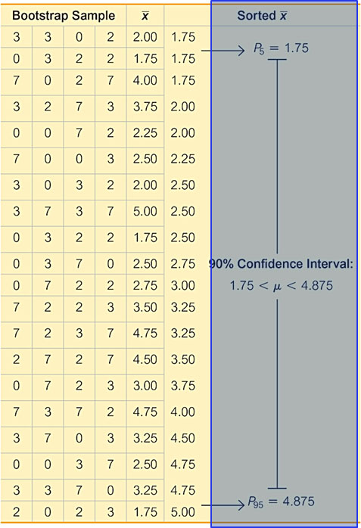
Example: Incomes: Bootstrap CI for Mean (10 of 10)
Solution
Bootstrap Samples for μ.

Slide 32
Standard Deviations
In Section 7-3 we noted that when constructing confidence interval estimates of population standard deviations or variances, there is a requirement that the sample must be from a population with normally distributed values. Even if the sample is large, this normality requirement is much stricter than the normality requirement used for estimating population means. Consequently, the bootstrap method becomes more important for confidence interval estimates of σ or σ².

Slide 33
Example: Incomes: Bootstrap CI for Standard Deviation (1 of 4)
Use these same incomes (thousands of dollars) from the previous example: 0, 2, 3, 7. Use the bootstrap resampling procedure to construct a 90% confidence interval estimate of the population standard deviation σ, the standard deviation of the annual incomes of the population of the author’s statistics students.

Slide 34
Example: Incomes: Bootstrap CI for Standard Deviation (2 of 4)
Solution
Requirement Check
The same requirement check used in the previous example applies here.

Slide 35
Example: Incomes: Bootstrap CI for Standard Deviation (3 of 4)
Solution
The same basic procedure used in the previous example is used here. The previous example already includes 20 bootstrap samples, so here we find the standard deviation of each bootstrap sample, and then we sort them to get this sorted list of sample standard deviations:
1.26 1.26 1.26 1.41 1.41 2.22 2.31 2.38 2.63 2.63
2.87 2.87 2.89 2.94 2.99 3.30 3.32 3.32 3.32 3.56

Slide 36
Example: Incomes: Bootstrap CI for Standard Deviation (4 of 4)
Solution
The 90% confidence interval limits are found from this sorted list of standard deviations by finding P₅ and P₉₅. Using the methods from Section 3-3, we get P₅ = 1.26 and P₉₅ = 3.44. The 90% confidence interval estimate of the population standard deviation s is 1.26 < σ < 3.44, where the values are in thousands of dollars.

